Slide 1
Journey Scrapbook
Shashikant Suman

Slide 2
Week One
14th Aug – 18th Aug

Slide 3


Business Analysis
Business Analysis is the practice of enabling change in organizational context, by defining needs and recommending solutions that deliver value to stakeholders.
Software Development Life Cycle (SDLC) is a framework that defines the steps involved in the development of the software at each phase.

Slide 4
SDLC Steps
Requirement gathering and analysis
1
Design
2
Coding
3
Testing
4
Deployment
5
Maintenance
6

Slide 5
Requirements
Elicitation
Modelling
Management
Brainstorming
Document Analysis
Focus Groups
Interviews
Prototyping
Workshops
Survey/Questionnaire
It identifies the requirements that an application must meet in order to solve the business problem
Scenario-based
Class-based
Data-based
Iterative set of activities to ensure that elicitation, documentation, refinement and changes are adequately dealt with.
Reduces cost, time and risk and improves quality.
Techniques – WBS, Gantt Chart, Critical Path Method etc.

Slide 6
Waterfall Model
Linear model, easy to understand and use.
Milestones are well understood and provides structure to inexperienced staff.
Used when requirements are well known
Used when the tech to be used is known
No backtracking to previous stages
Product is visible after a long time

Slide 7
Agile Methodology
It is an iterative, short framework.
Comprises of sprints. Each sprint focuses on a subset of requirements.
In general, a sprint lasts from anywhere between 1 week to 4 weeks.
Plan -> Design -> Build -> Test -> Review

Slide 8
Why?
When?
Higher customer satisfaction
Better quality and productivity
Flexibility and adaptability to accept changes
Lack of clearly defined requirements
High degree of complexity
High degree of novelty(new concepts)
Aggressive deadlines

Slide 9
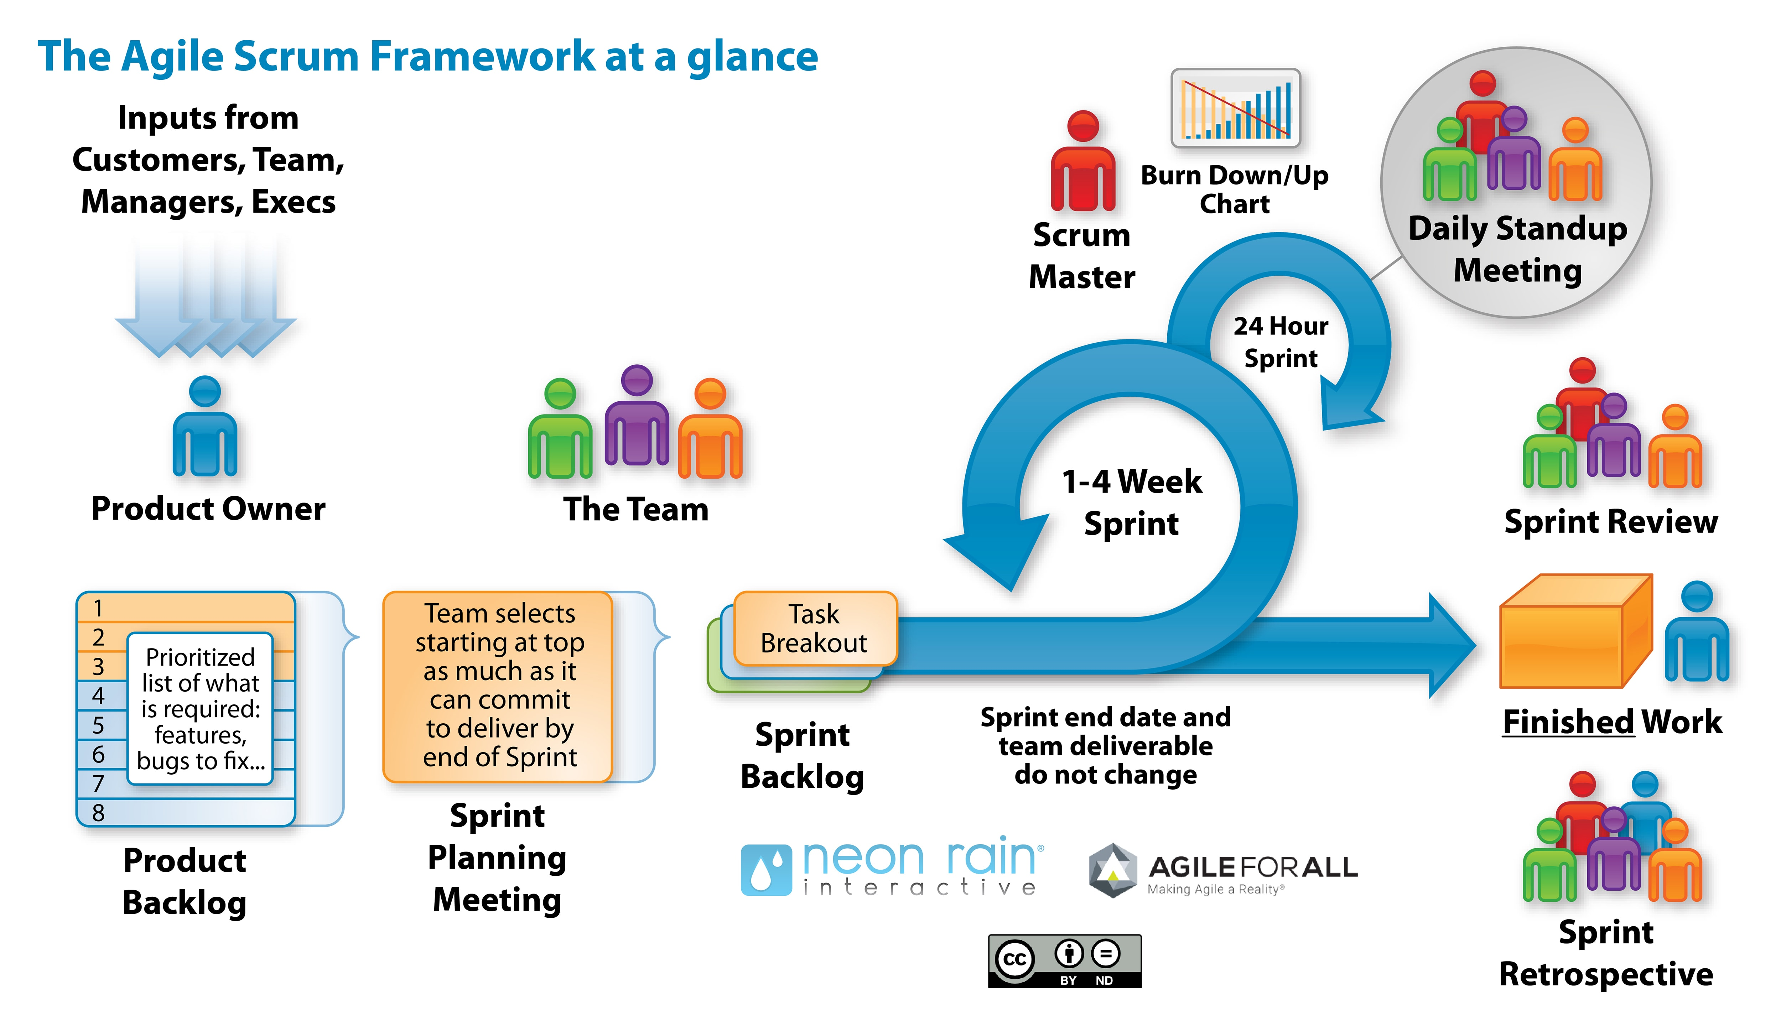

Slide 10
Week Two
21st Aug – 25th Aug

Slide 11
Day 1- Agile
User Story – A user story is an informal, general explanation of a software feature written from the perspective of the end user or customer
Burn Up Chart – Shows the work you have completed and total project work.
Burn Down Chart – Shows the work left to do versus time.
Velocity Chart – Shows tasks completed against tasks set.

Slide 12
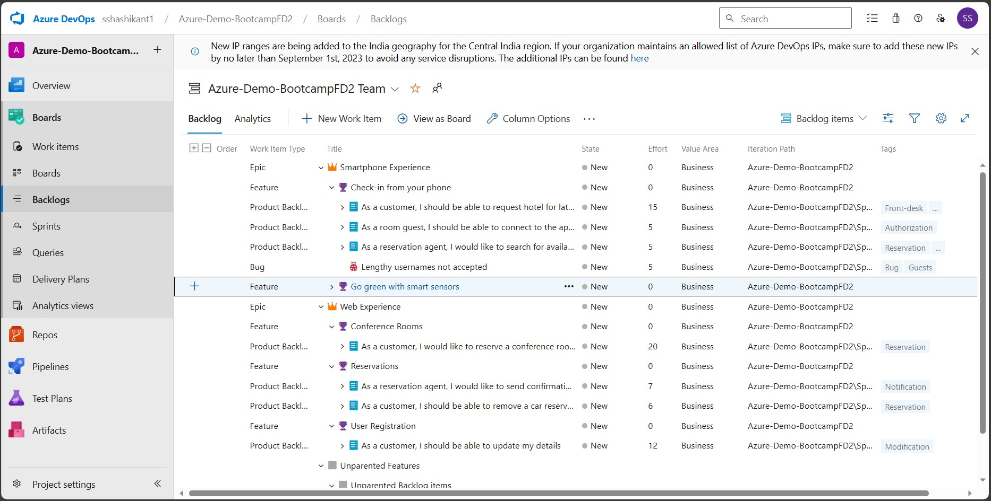

Slide 13
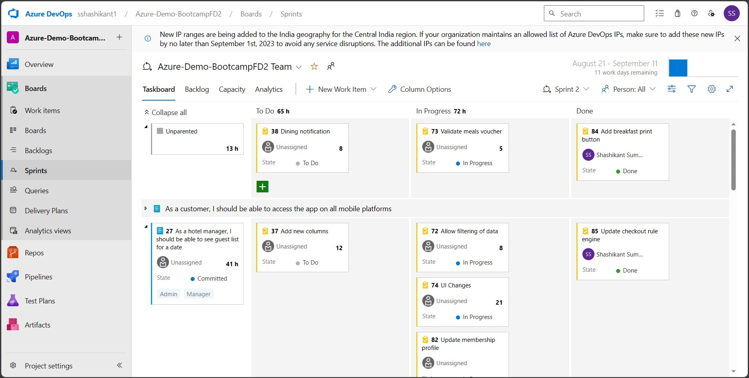

Slide 14
Day 2- DBMS
NoSQL – Not Only SQL; stores data differently than a relational database. E.g. – MongoDB, Redis, CouchDB, etc.
Normalization – Process of organizing data for minimum redundancy. 1NF, 2NF, 3NF, BCNF, 4NF, 5NF.
Joins – It is the concept of combining multiple related tables to resolve complex queries. Types – Inner, Outer, Left, Right, Cross, Self.

Slide 15
PostgreSQL
An Open-Source Object-Relational Database Management System.
Supports both relational (SQL) and non-relational (JSON) queries.
Has Multi-Version Concurrency Control
Compatible with multiple OS, programming languages and data types

Slide 16
Day 3- Software Testing
Process of checking if the application can confidently satisfy user requirements. It is done to ensure product quality.
Test Driven Development – Tests are written before the code; the aim is to write code which can pass the test cases.
Behavior Driven Development – Tests in form of “ Given – When – Then “
Acceptance Test Driven Development – User-centric acceptance tests are used.

Slide 17
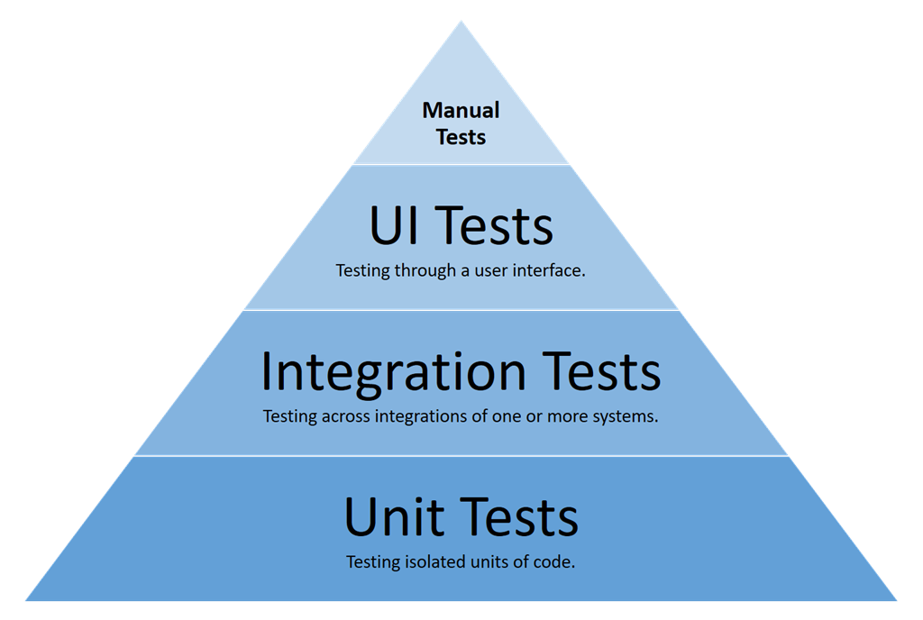
Testing Life Cycle
Test Strategy
Test Plan
Test Design
Test Environment
Test Execution
Defect Logging
Test Closure

Slide 18
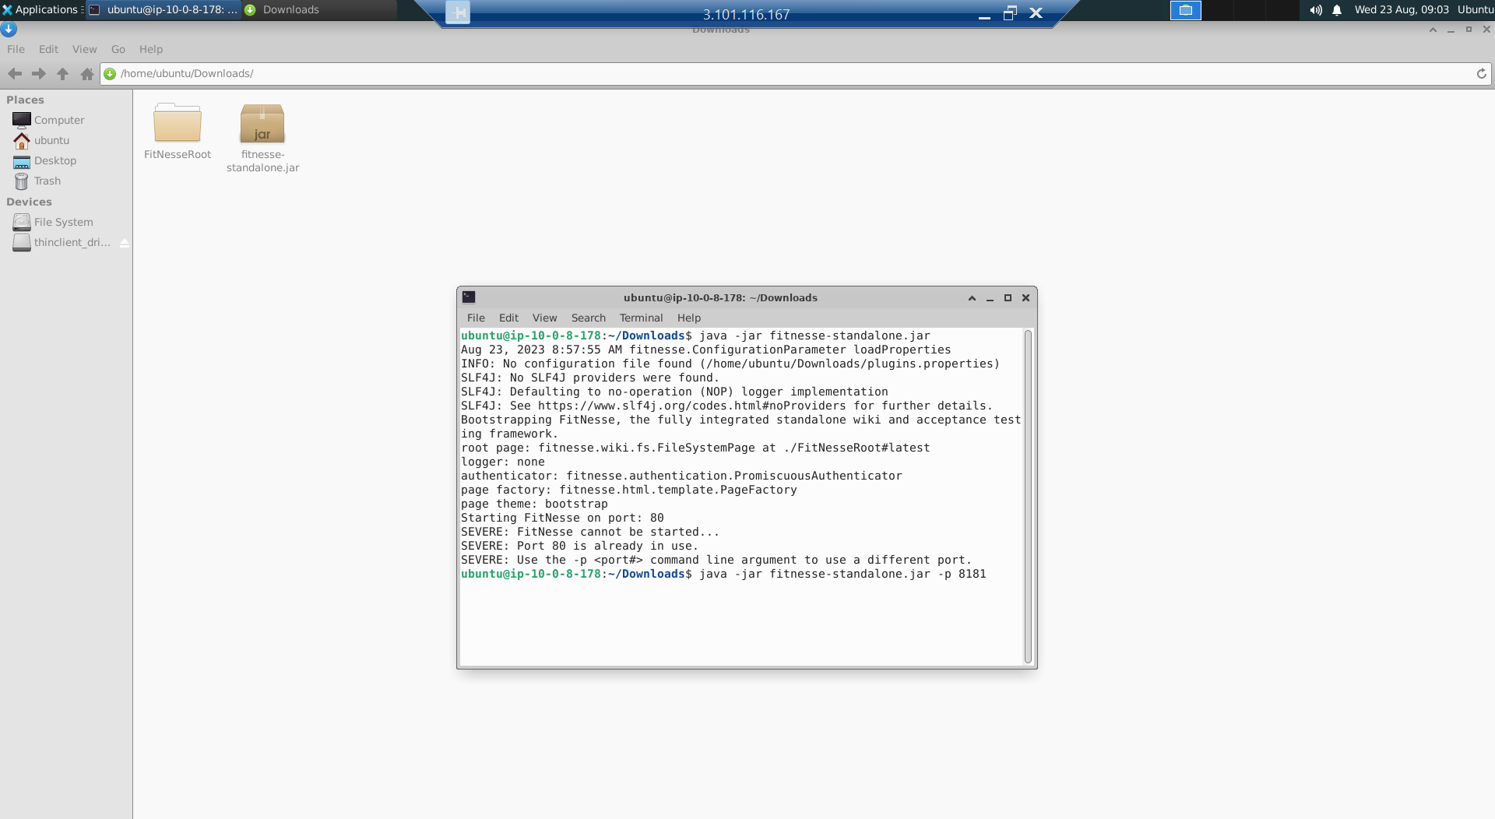

Slide 19
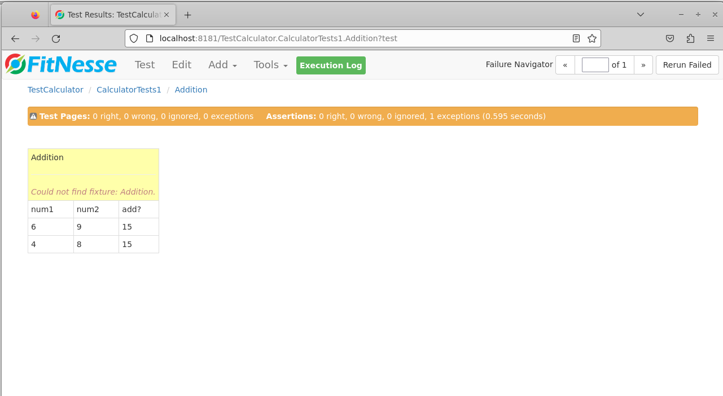

Slide 20
Day 4- DevOps
Continuous Development
Continuous Testing
Continuous Deployment
Continuous Integration
Continuous Monitoring
Continuous Feedback
Continuous Operations
Integrates and automates the work of software development (Dev) and IT operations (Ops) as a means for improving and shortening the systems development life cycle.

Slide 21
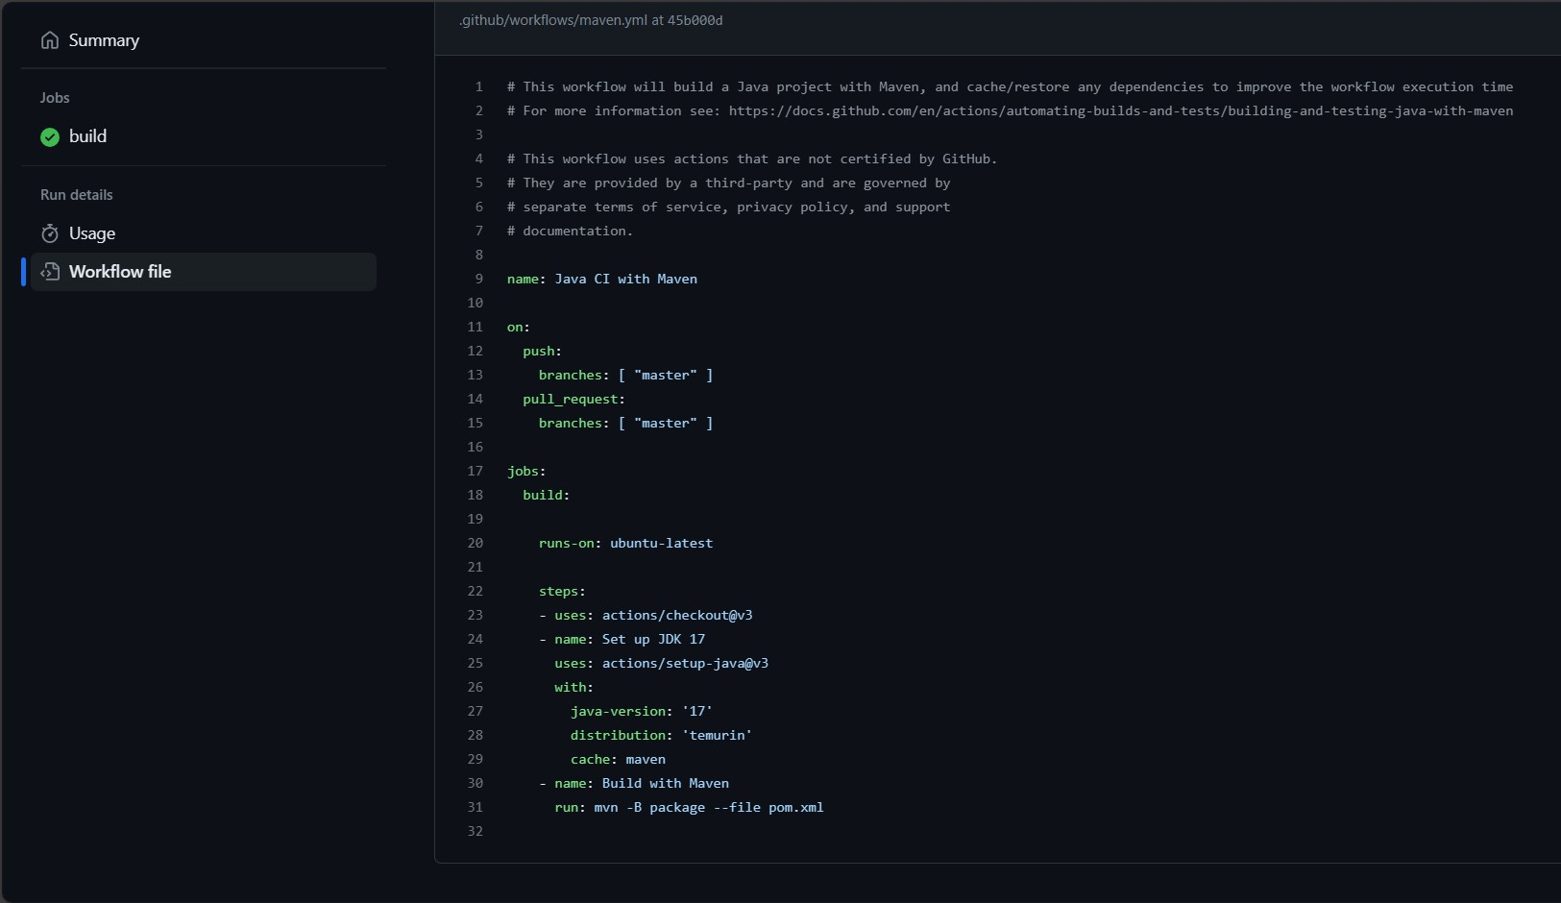

Slide 22
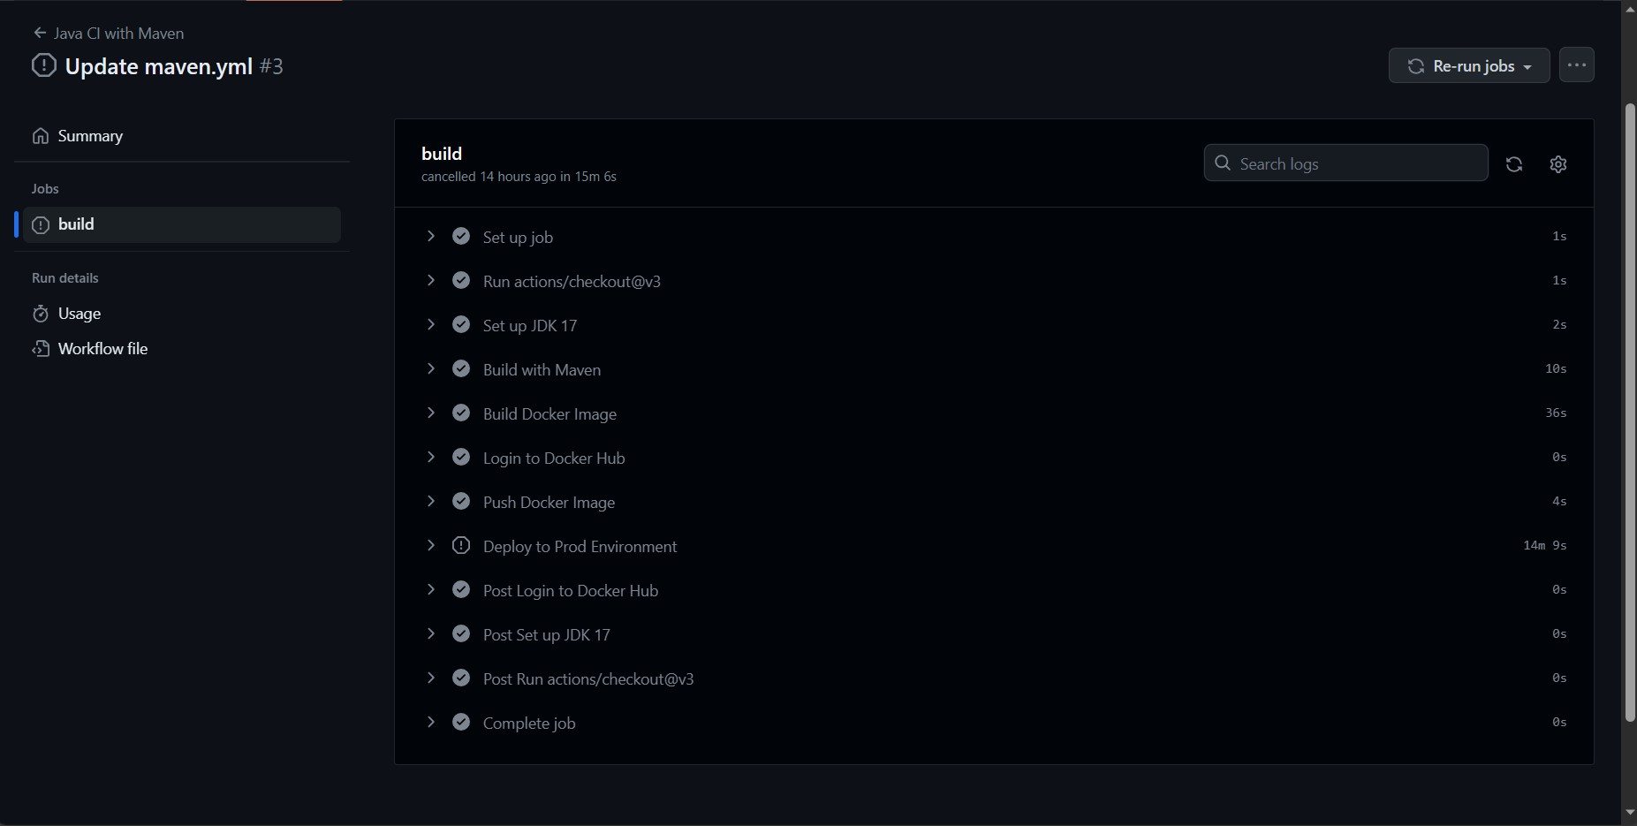

Slide 23
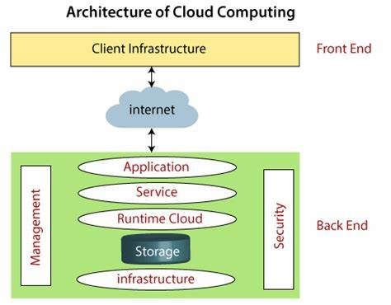
Day 5- Cloud
On-demand availability of computer system resources, especially data storage and computing power, without direct active management by the user.
Public, Private and Hybrid.
Three models: IaaS, PaaS, SaaS.

Slide 24
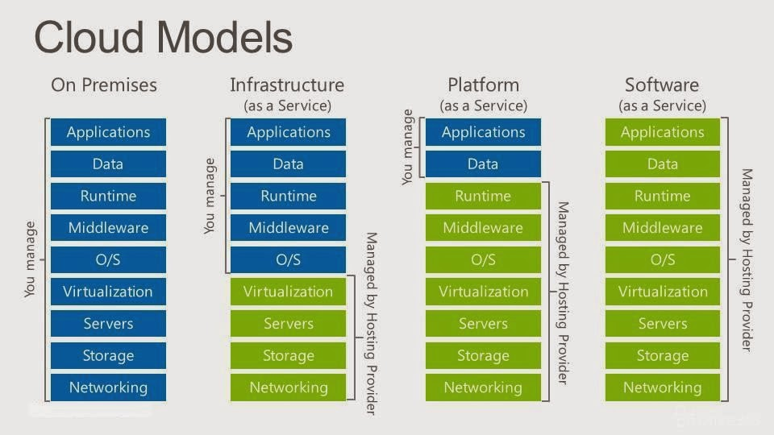

Slide 25
Week Three
28th Aug – 1st Sep

Slide 26
Case Study
Setup Azure Boards to manage Scrum project progress
Forked GitHub repository and added feature branches
Built the application with Maven on Azure VM
Used Prometheus for monitoring
Dockerized the application
Configured Azure Web App
Implemented GitHub Actions to automate the process
Implementing a Seamless CI/CD Workflow for a Spring Boot Application using Azure Boards, Azure, Git, Maven, Docker, Github, Github Actions

Slide 27
Custom IDA Bootcamp
Transactions
OLAP
Data Warehouse
Cube
OLTP
Database
Facts
Dimensions
CRUD

Slide 28
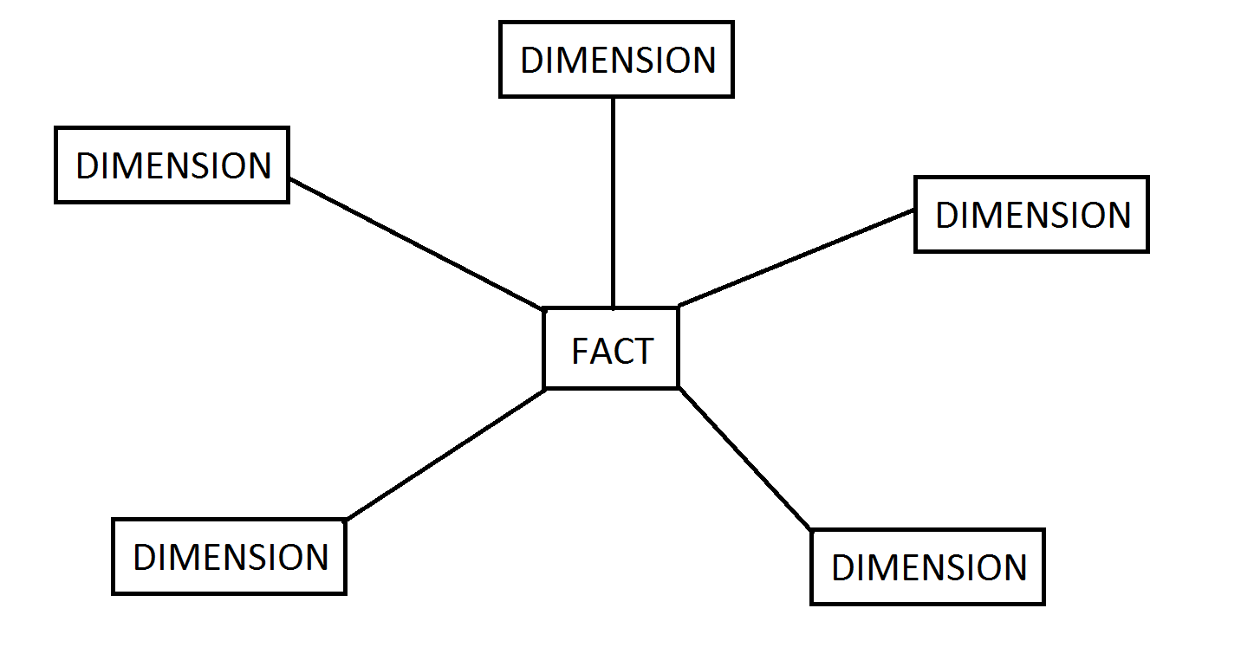
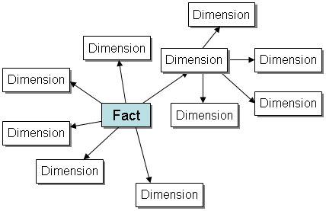
Data Warehousing Dimensional Model
Facts: Numeric data used for aggregation & summarization.
Dimensions: Has multiple data columns
Schemas: Star and Snowflake

Slide 29
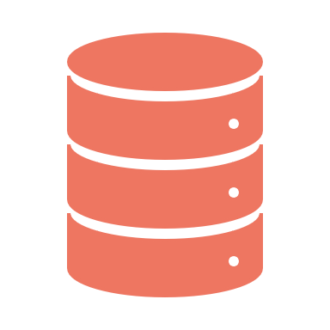
Big Data
Massive volumes of both structured and semi-structured data that is so large that it is difficult to process using traditional database and software techniques.
High Volume
High Velocity
High Variety
Hadoop – Framework to handle large distributed sets of data.

Slide 30
Azure Architecture and Services
Availability Zones: Physically separate datacenters within a region; protects against downtime; max 3 per region.
Region Pairs: Auto-replication of some services b/w pairs.
Resource Groups: Act as a container; manage and aggregate resources in a single unit.
Azure Functions: Serverless compute, abstracts server
Azure App Services: Fully managed platform; Build, deploy and scale Web Apps & APIs.

Slide 31
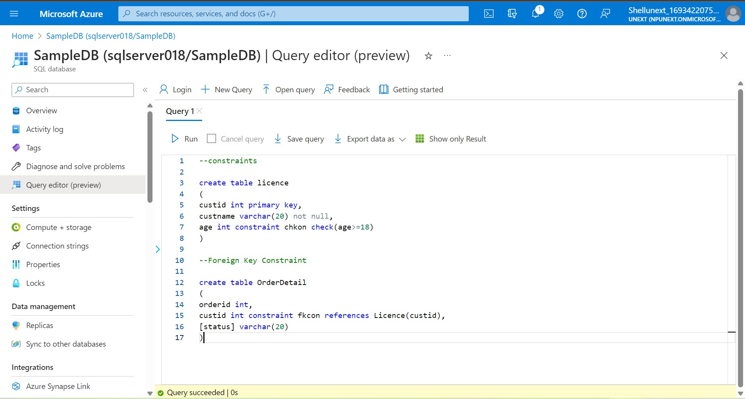

Slide 32
Azure Data Storage
Datalake: Low cost, high throughput, unlimited NoSQL data, no query support
Databricks: Wrapper around Spark, provides GUI, for predictive analysis, fast ML processing.

Slide 33
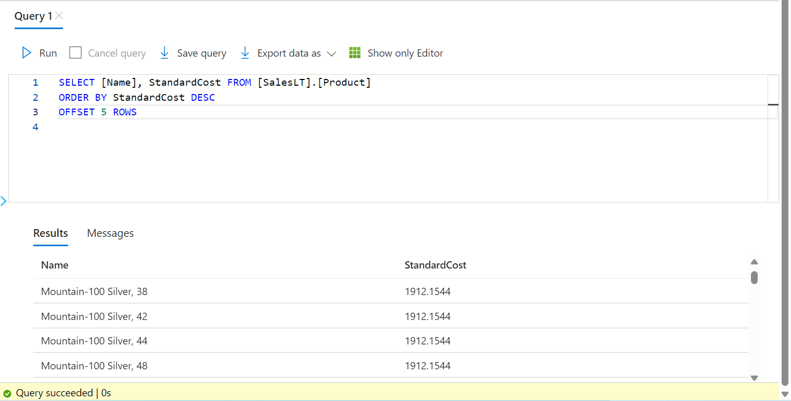
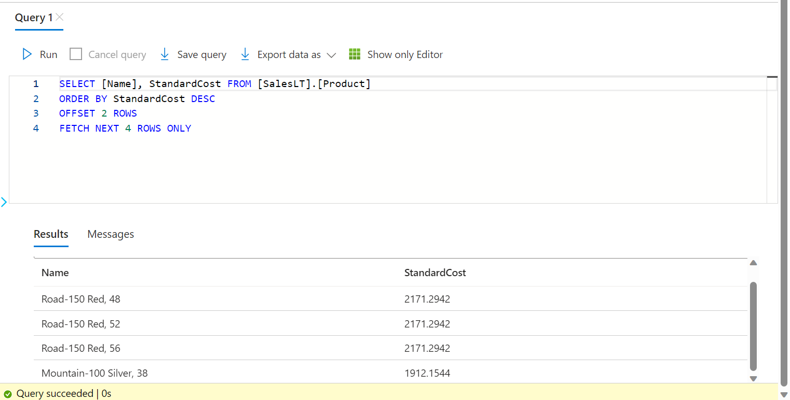
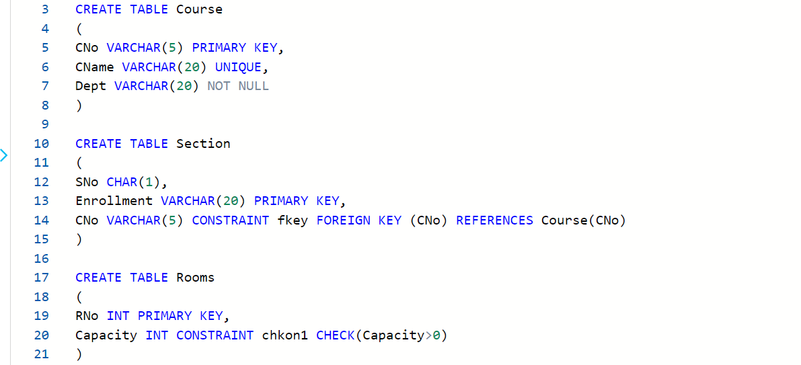
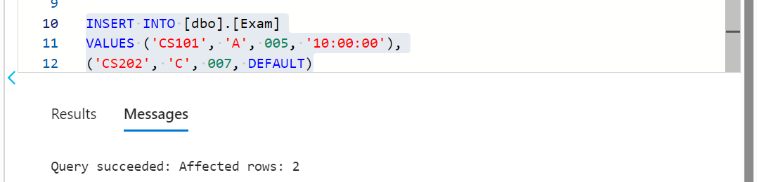

Slide 34
Joins
Combine rows from multiple tables by specifying matching criteria.
Usually based on primary key – foreign key relationships.
Inner, Left, Right, Outer, Cross, Self.
ANSI SQL-89 Syntax (Not recommended, cartesian product)
SELECT … FROM Table1, Table2 WHERE <predicate>
ANSI SQL-92 Syntax (Preferred)
SELECT … FROM Table1 JOIN Table2 ON <predicate>

Slide 35
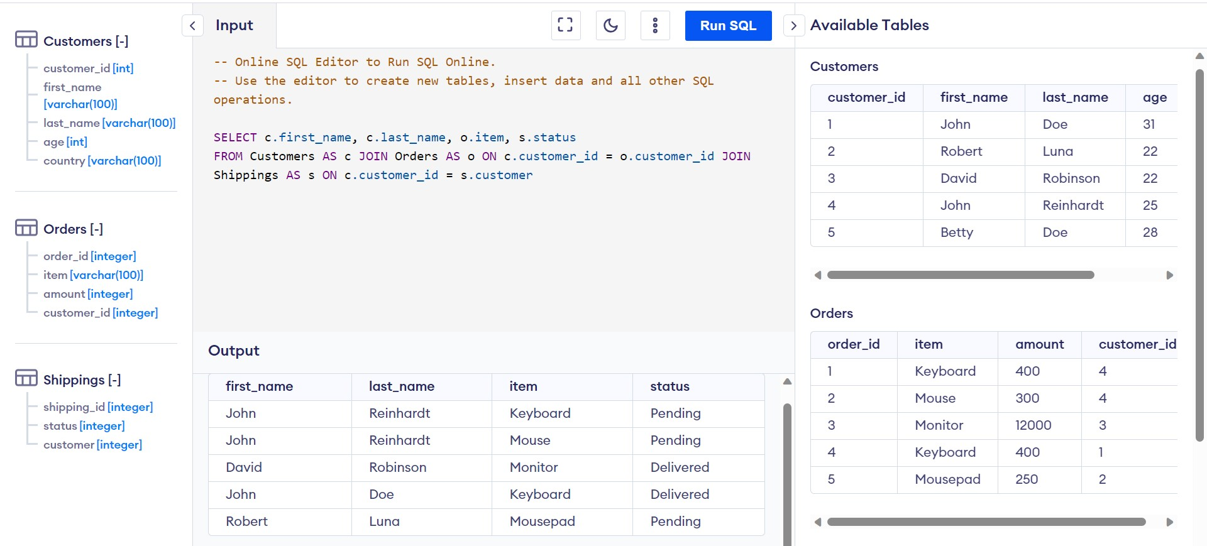

Slide 36
Subquery
Nested queries (queries within a query)
Scalar: Returns single value to outer query
Multi-valued: Returns a set of values to outer query
Self-contained:
Correlated:

Slide 37
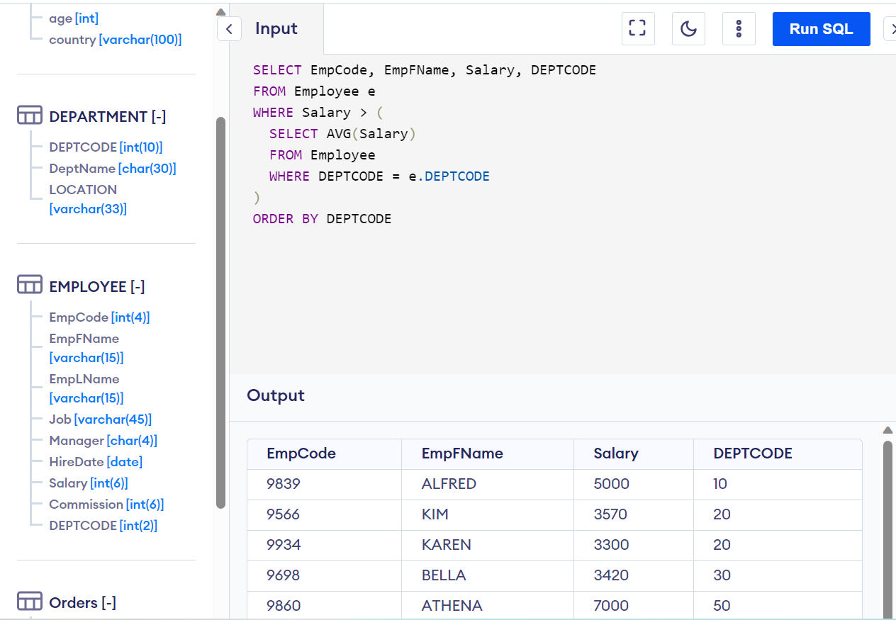

Slide 38
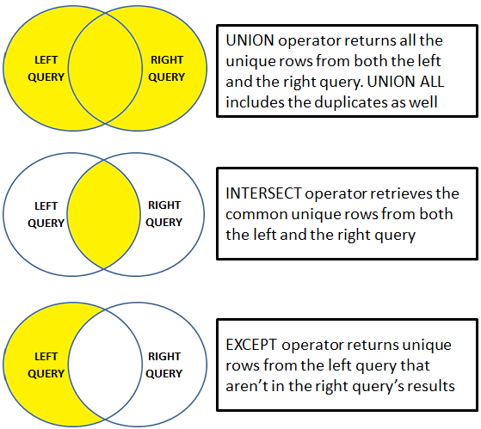
Set Operators
UNION
UNION ALL
INTERSECT
EXCEPT

Slide 39
Week Four
4th Sep – 8th Sep

Slide 40
Data Storage
Structured Data – Can be organized in row column format (Tables)
Semi-structured Data – Data in format of JSON, XML, etc.
Unstructured Data – Any format of data like audio, video, etc.
Benefits of storing data on Azure –
- Automated Backups - Multiple Data Types
- Global Replication - Support for Analytics
- Encryption Facilities - Virtual Disks

Slide 41
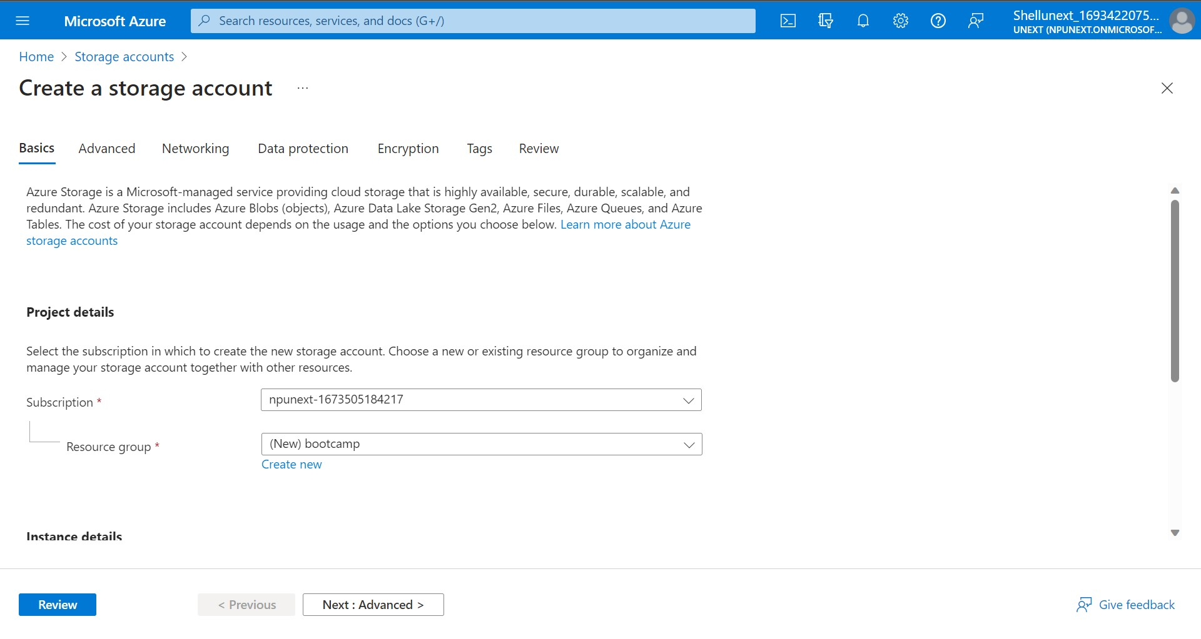

Slide 42
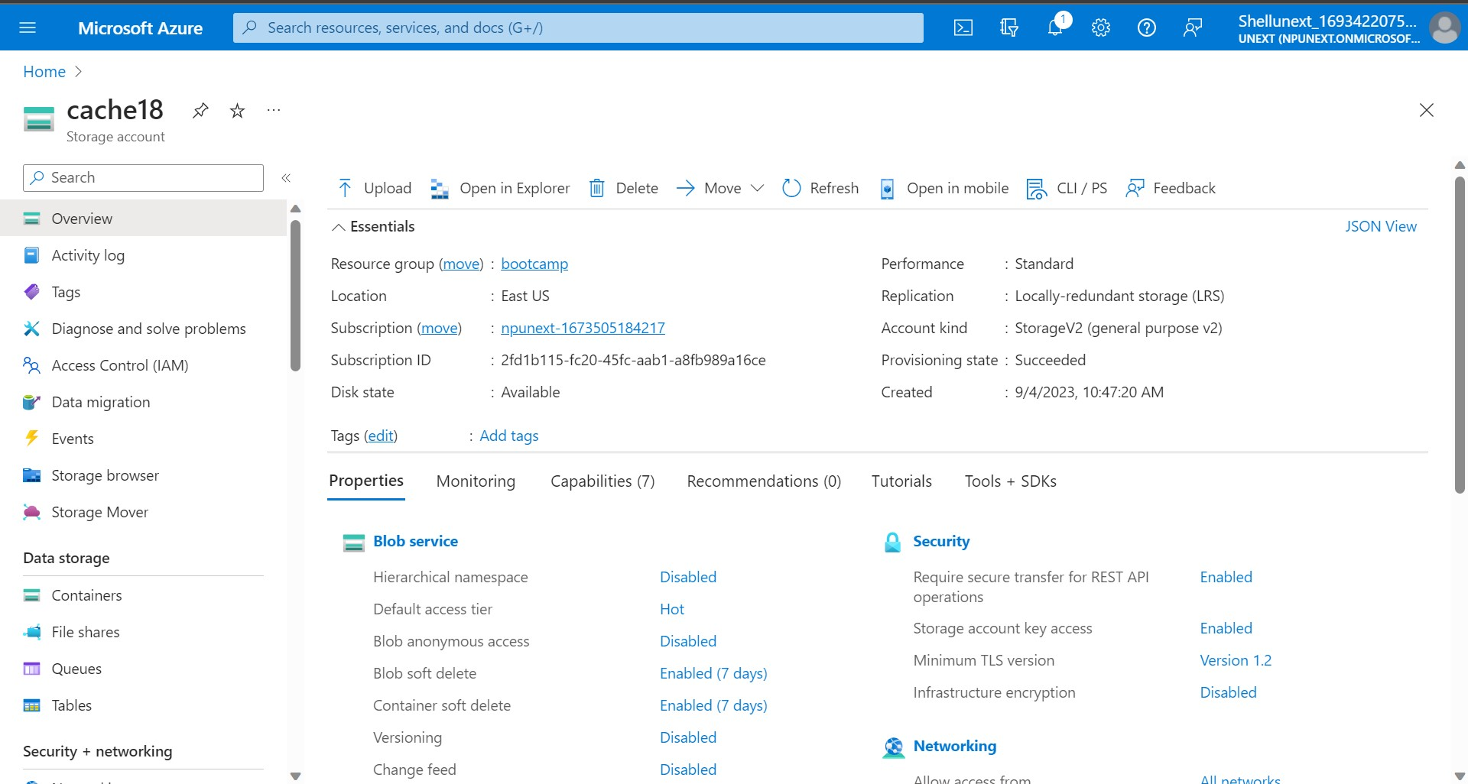
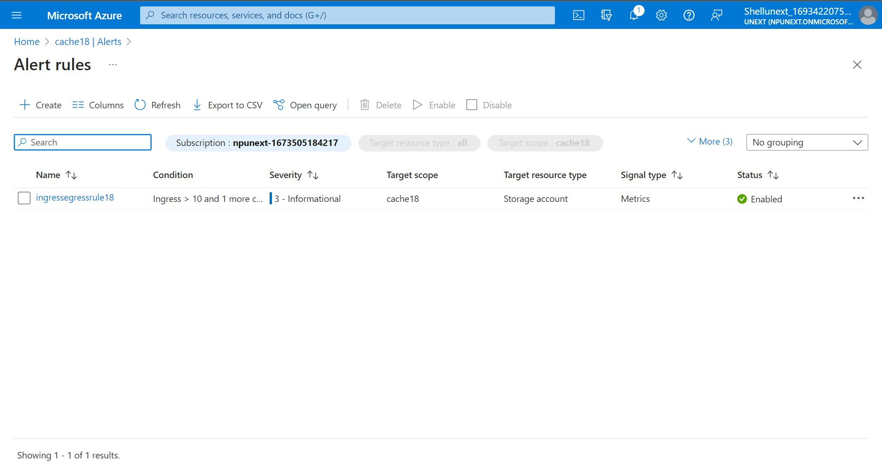
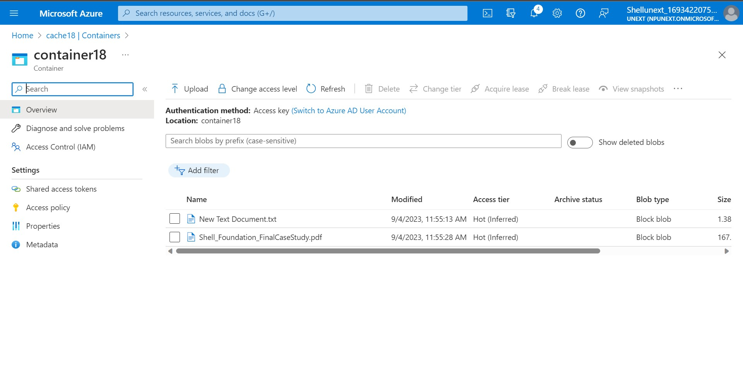
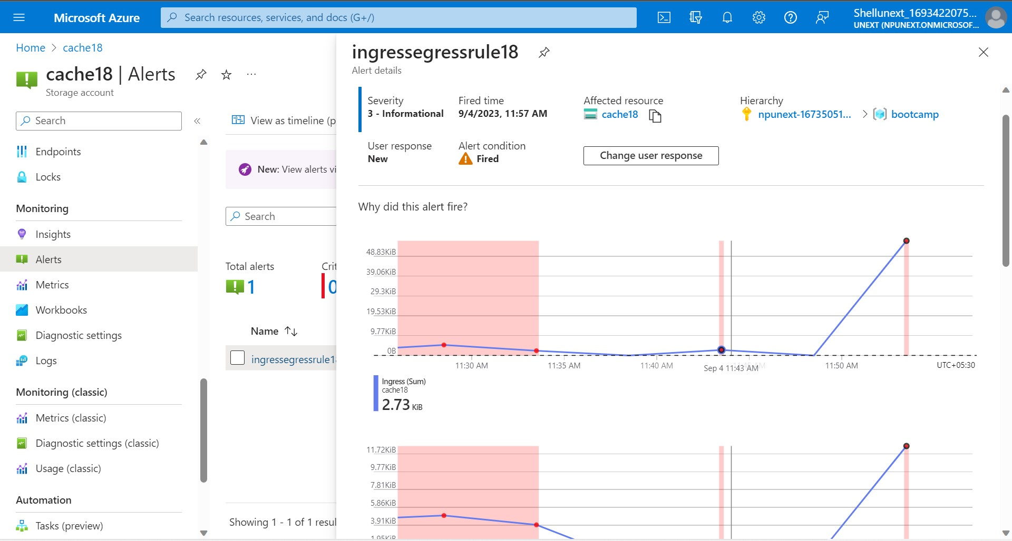

Slide 43
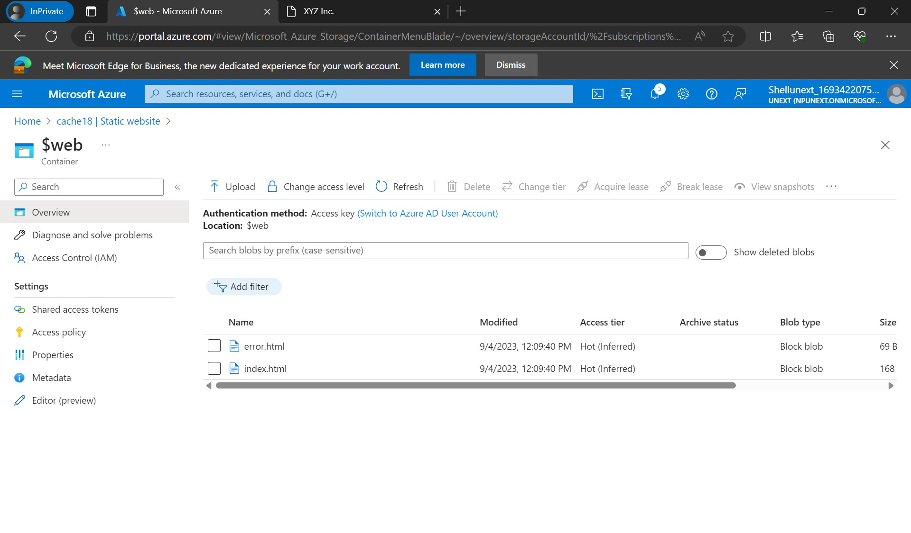
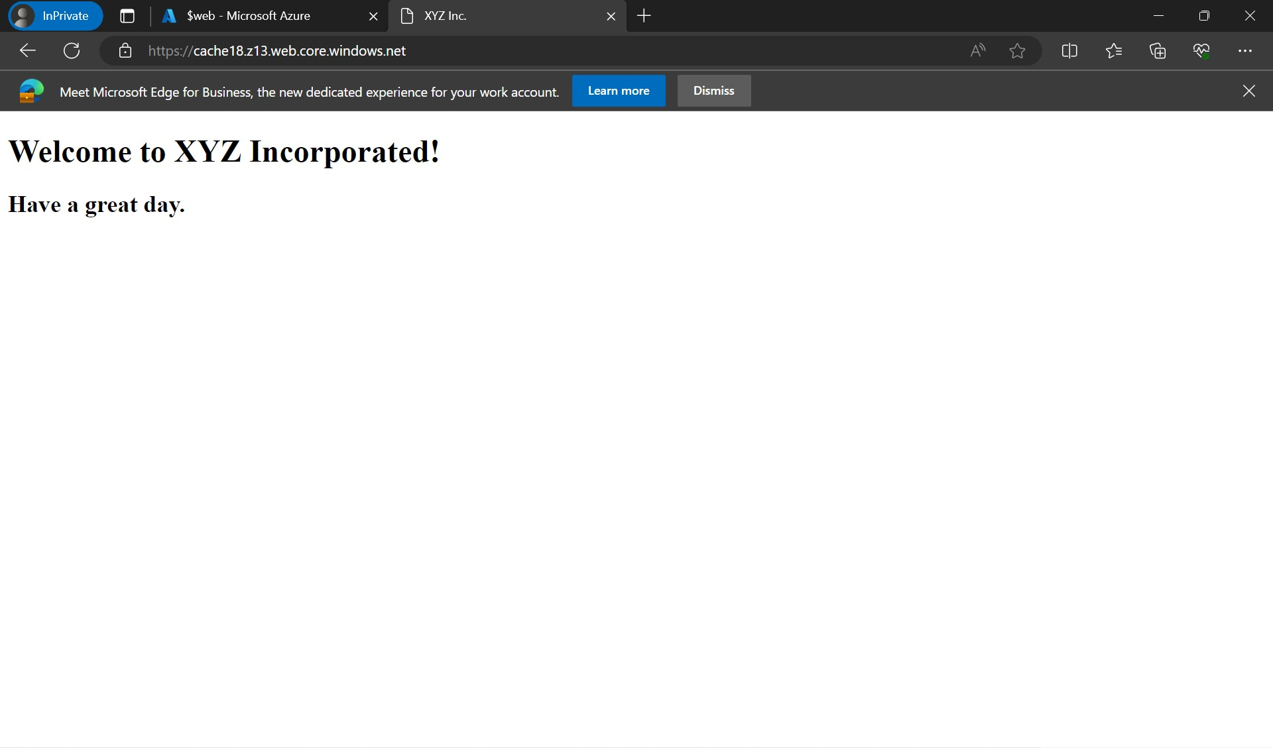

Slide 44
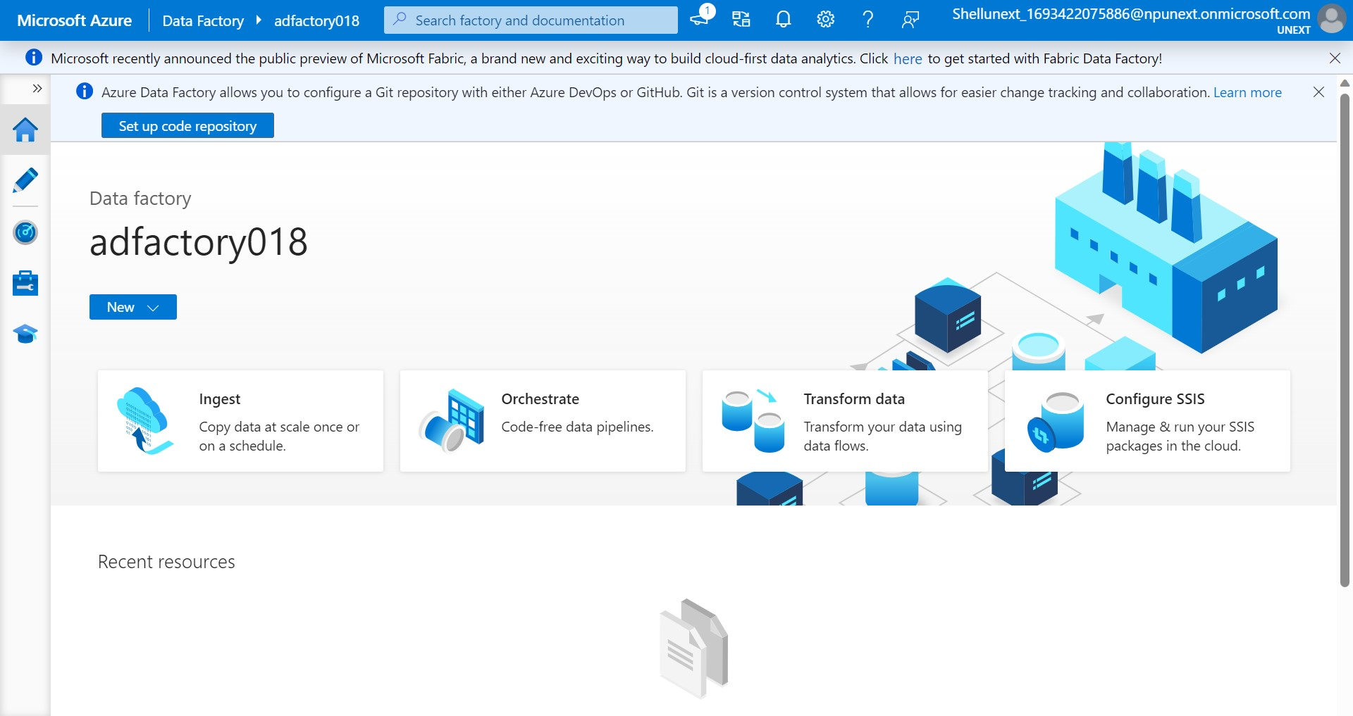
Azure Data Factory

Slide 45
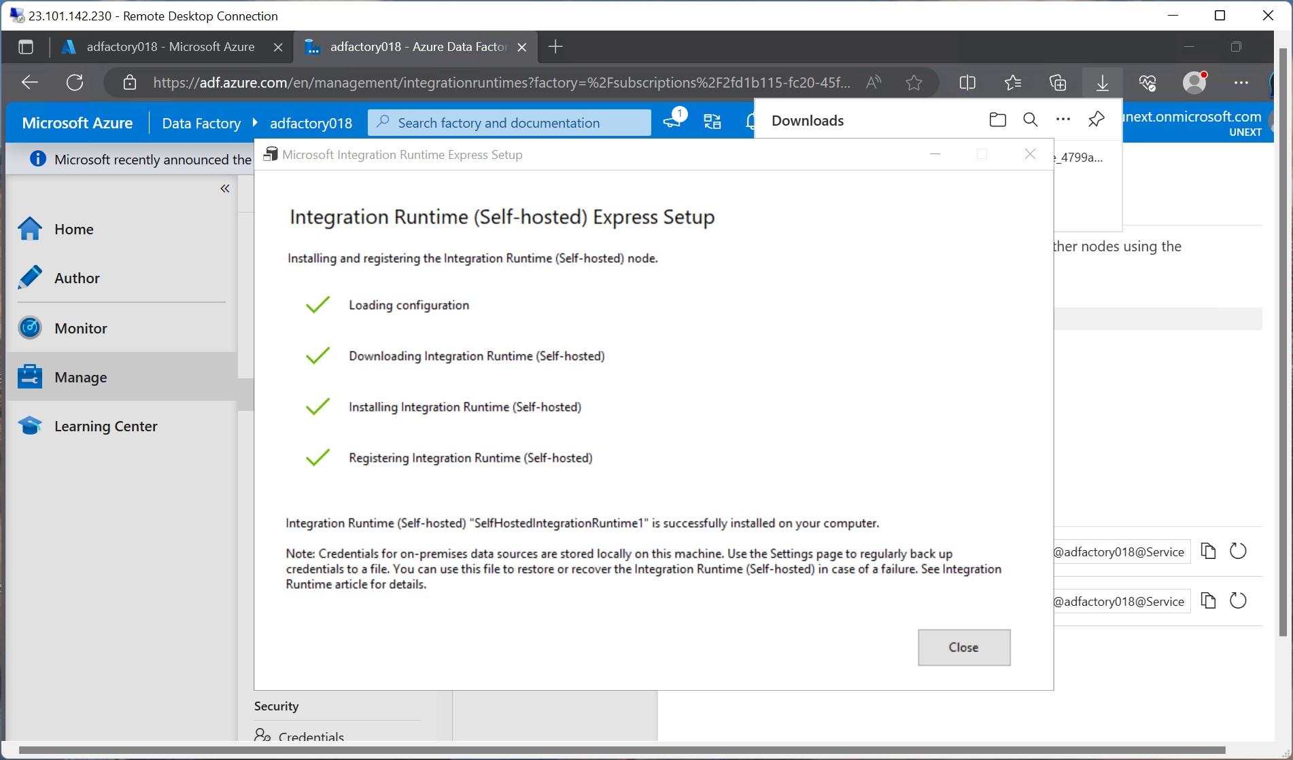

Slide 46
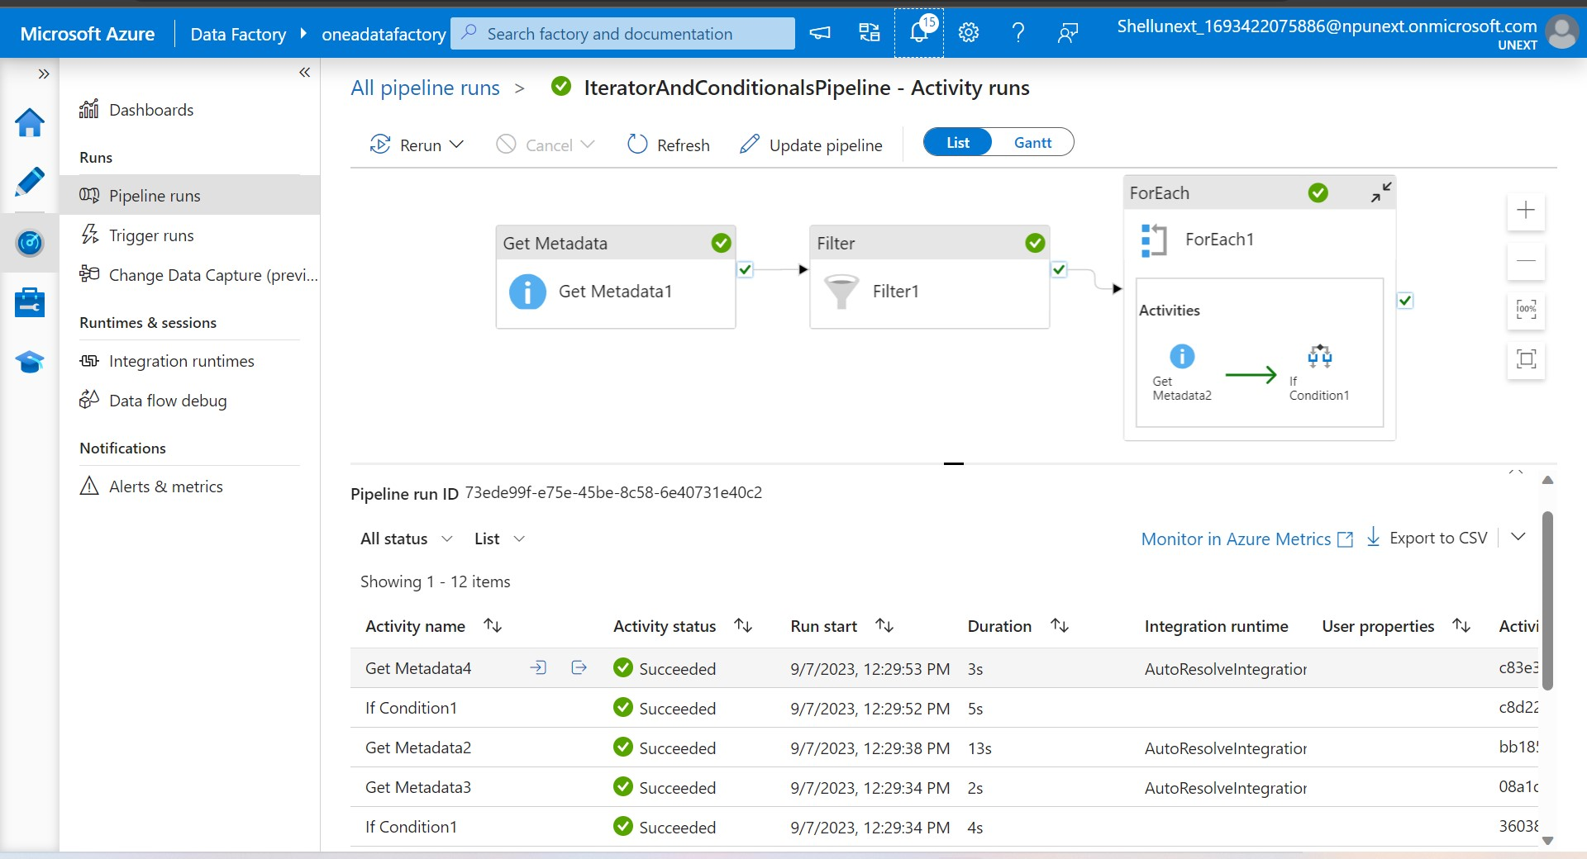
Control Flow in ADF

Slide 47
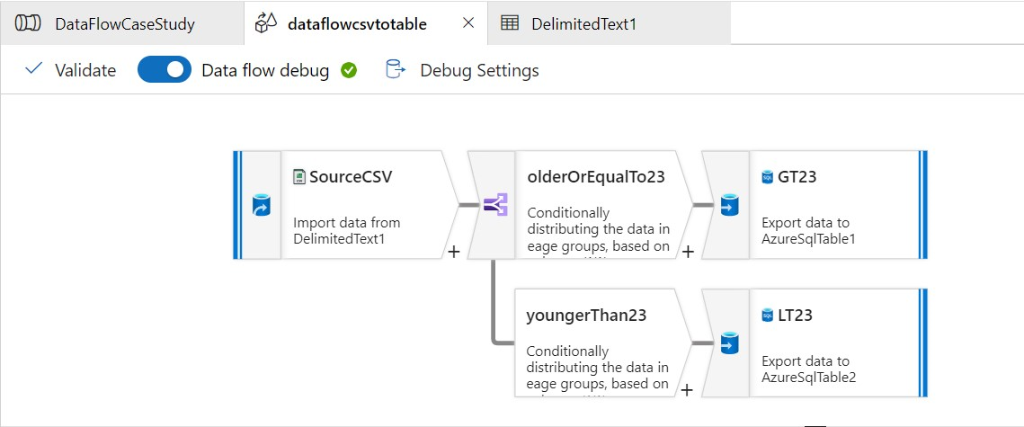
Data Flow in ADF

Slide 48
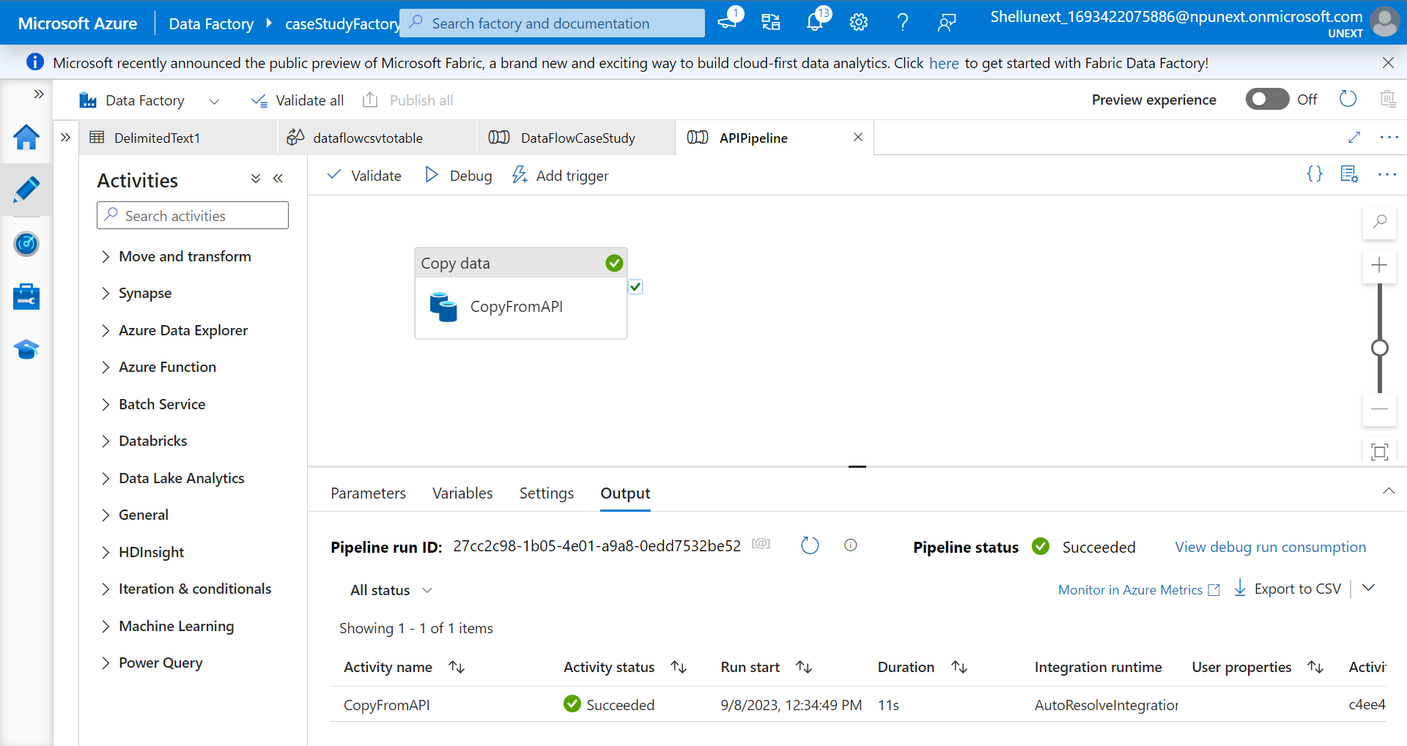
API Integration

Slide 49
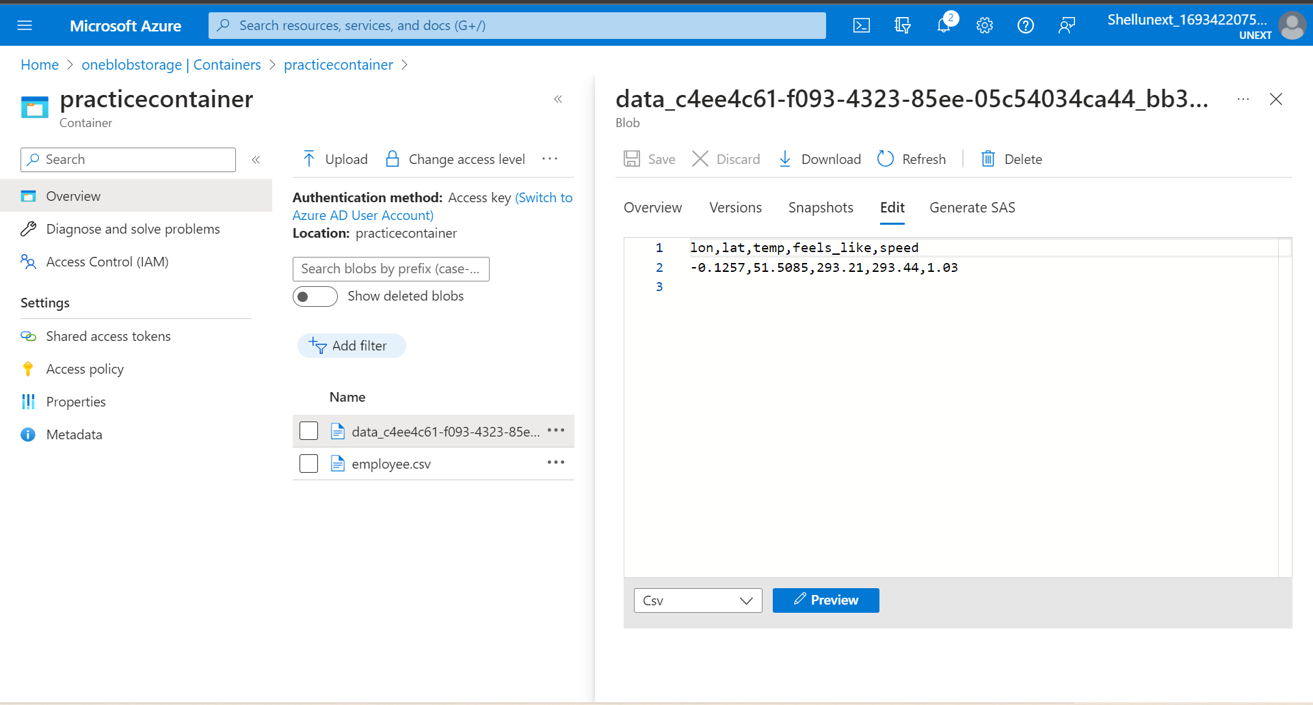

Slide 50
Week Five
11th Sep – 15th Sep

Slide 51
Azure Synapse Analytics
Cloud platform for data analytics
Large scale data warehousing
Advanced analytics
Data exploration and discovery
Real time analytics
Data integration
Integrated analytics
Components
Synapse SQL
Synapse Spark
Synapse Pipeline
Synapse Studio
Synapse Link

Slide 52
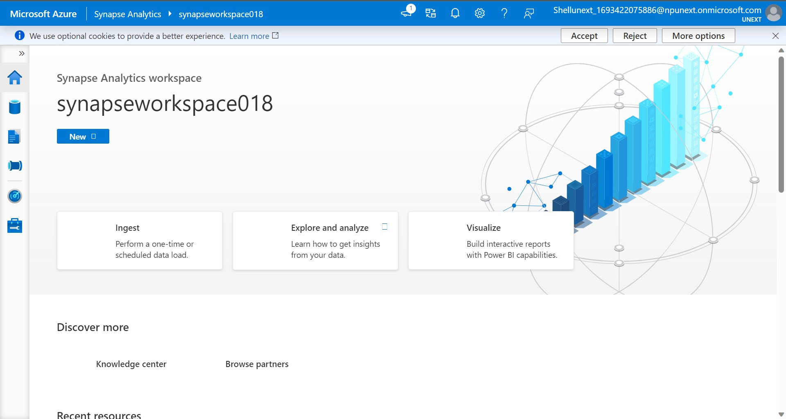
Synapse Studio

Slide 53
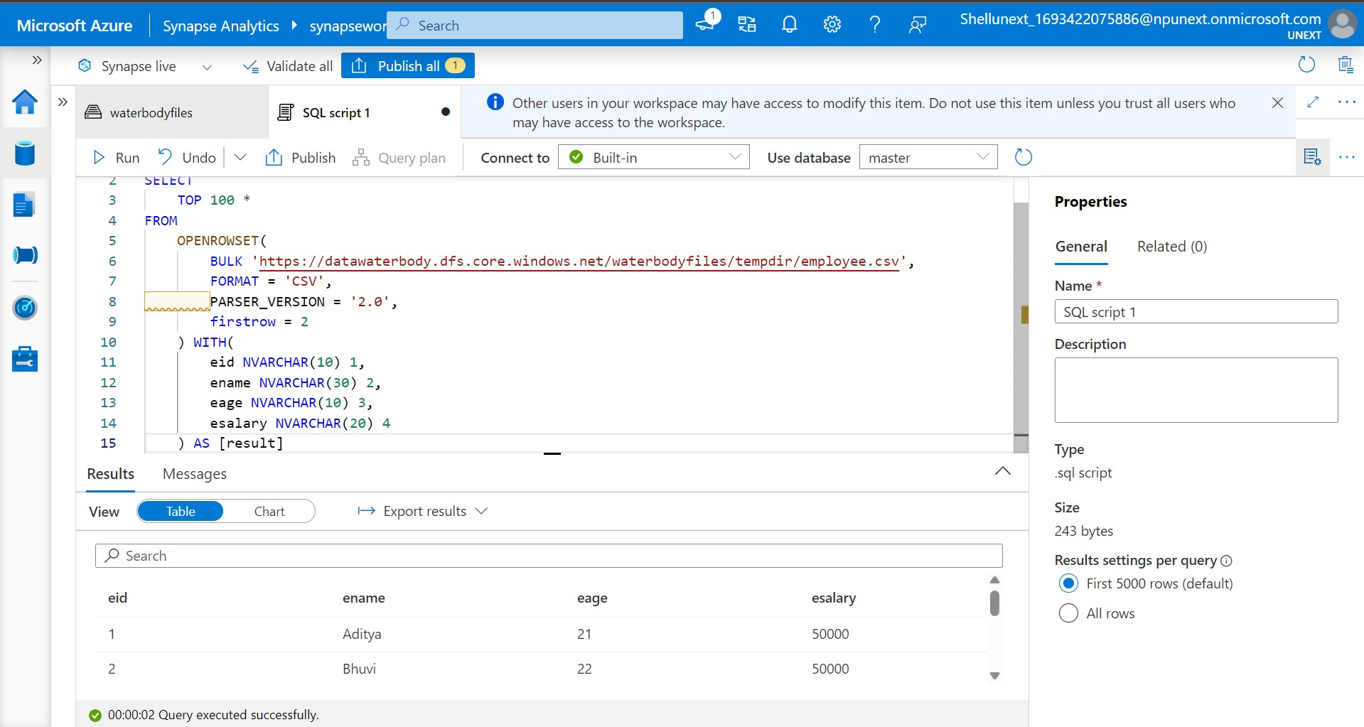

Slide 54
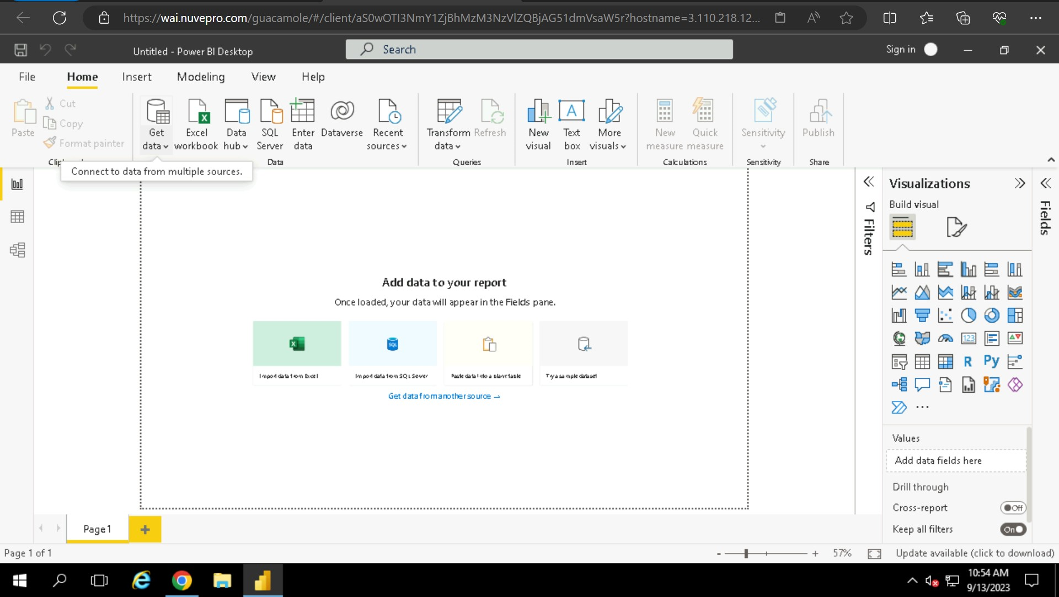
Power BI

Slide 55
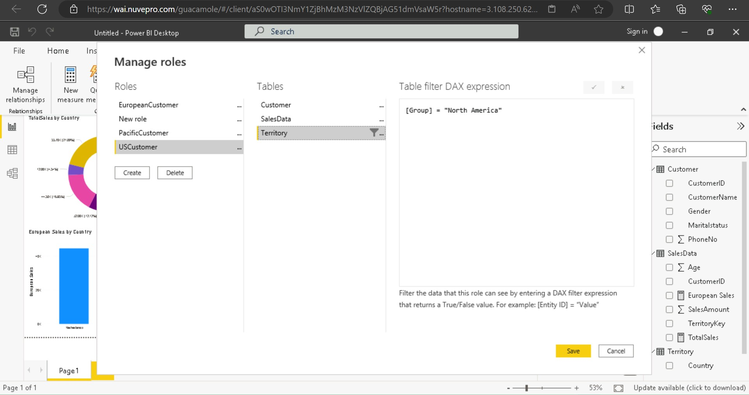

Slide 56
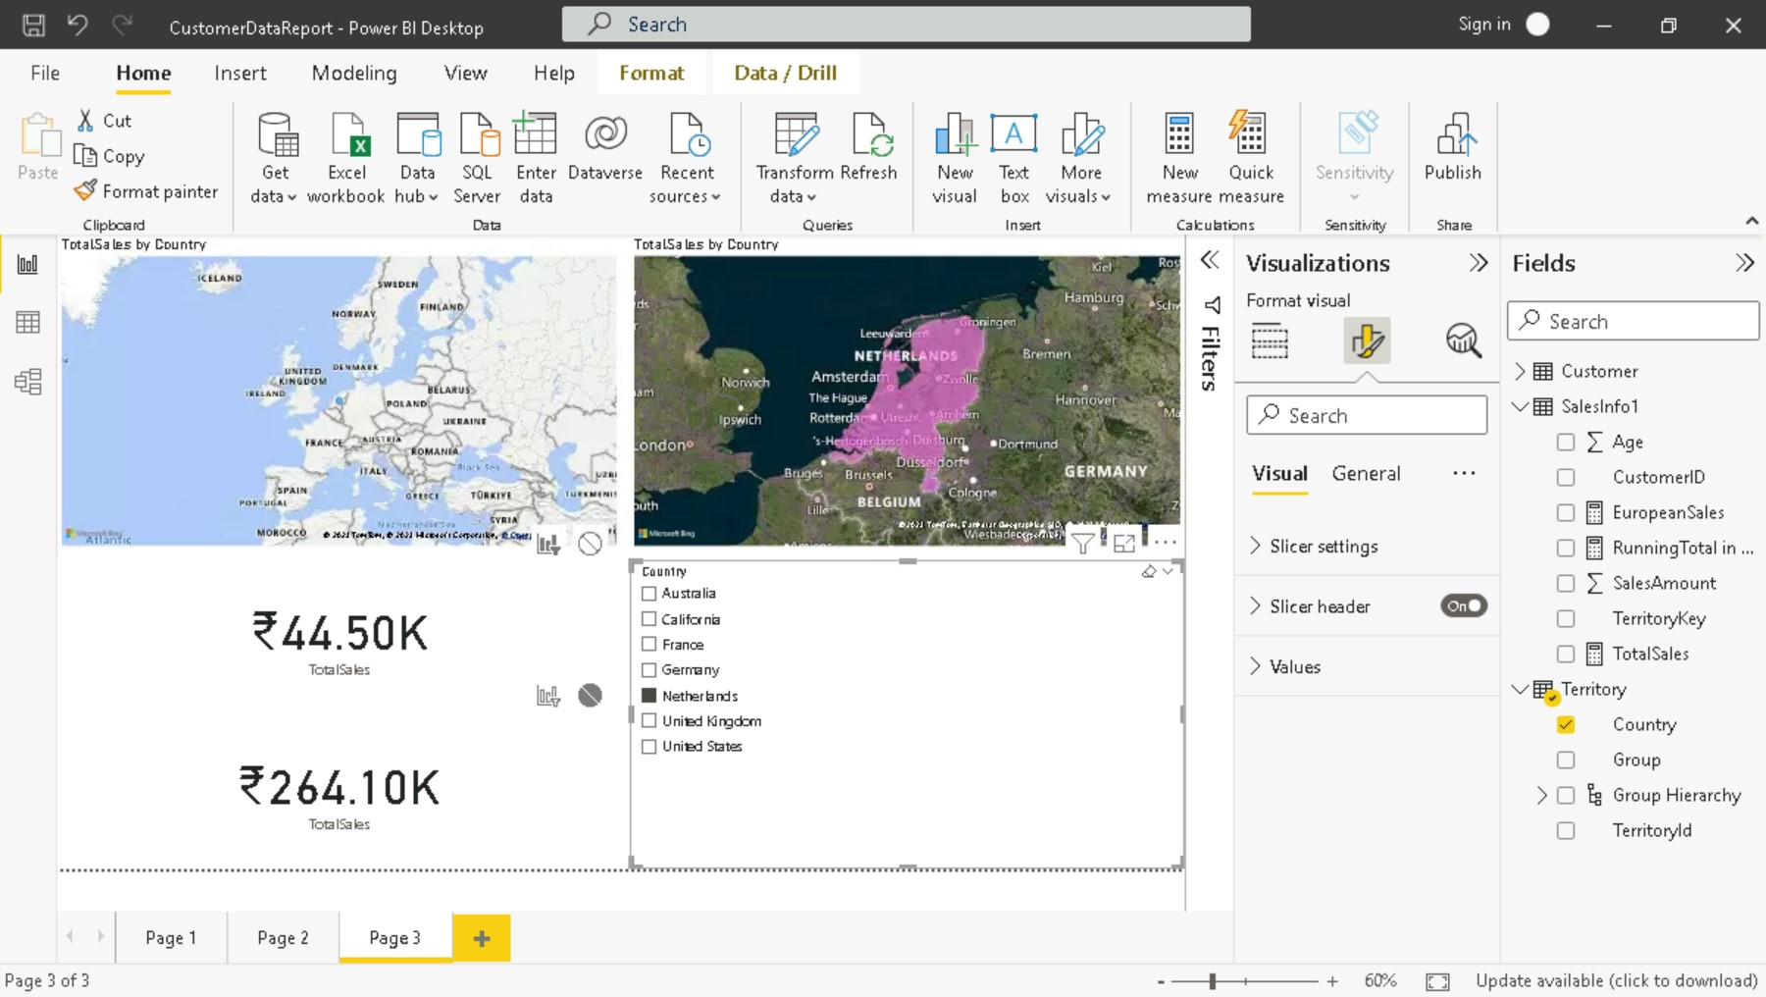

Slide 57
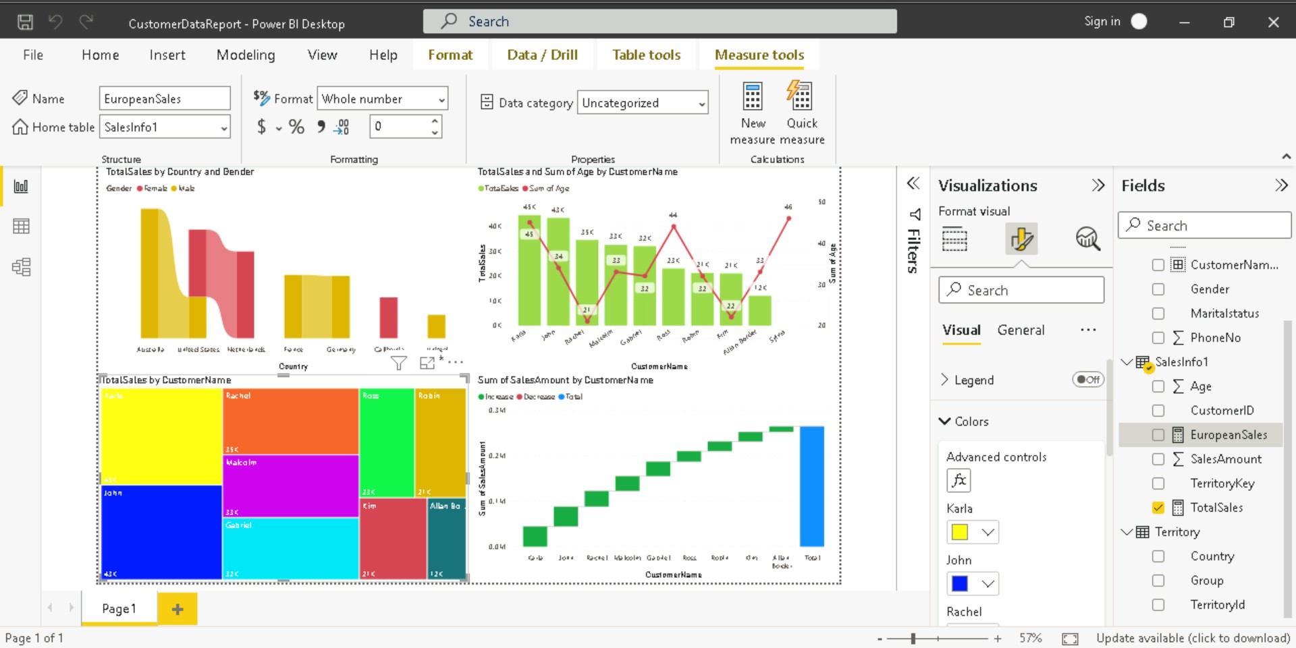

Slide 59
Python Programming
Use case
On a server to create web applications
Alongside software to create workflows
To connect to database systems. It can also read and modify files.
To handle big data and perform complex mathematics.
Why
Platform independent
Readable, concise
Dynamically typed
Flexible (can be functional, procedural and object-oriented)

Slide 60
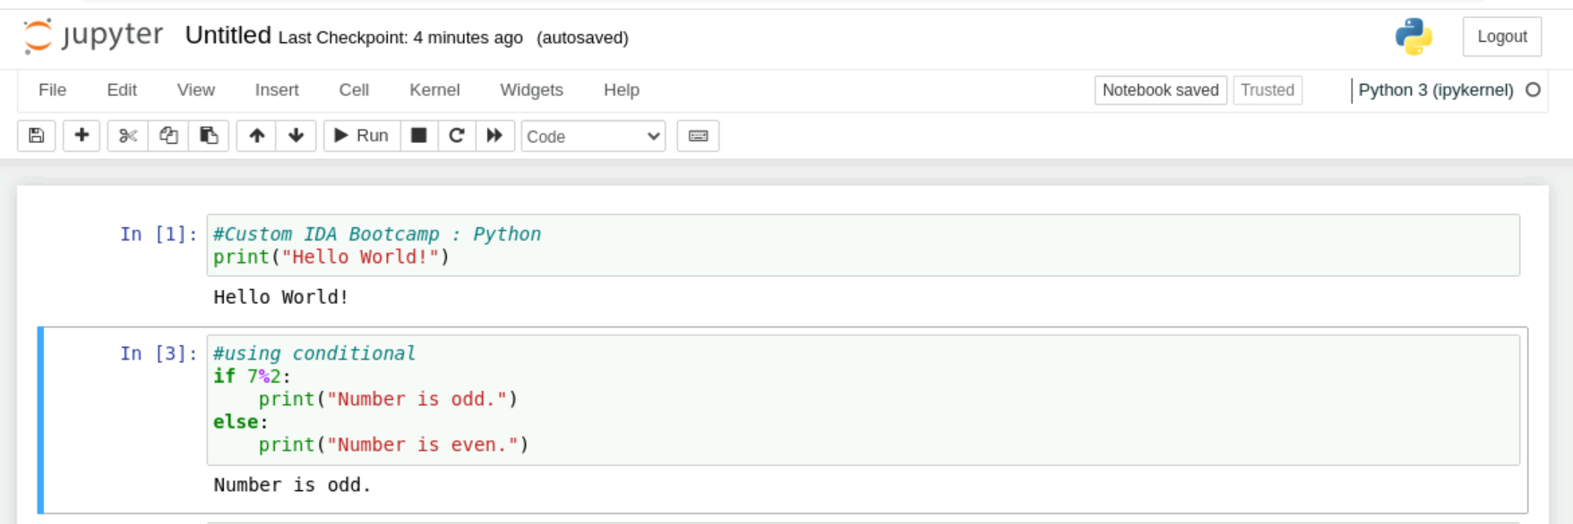

Slide 61
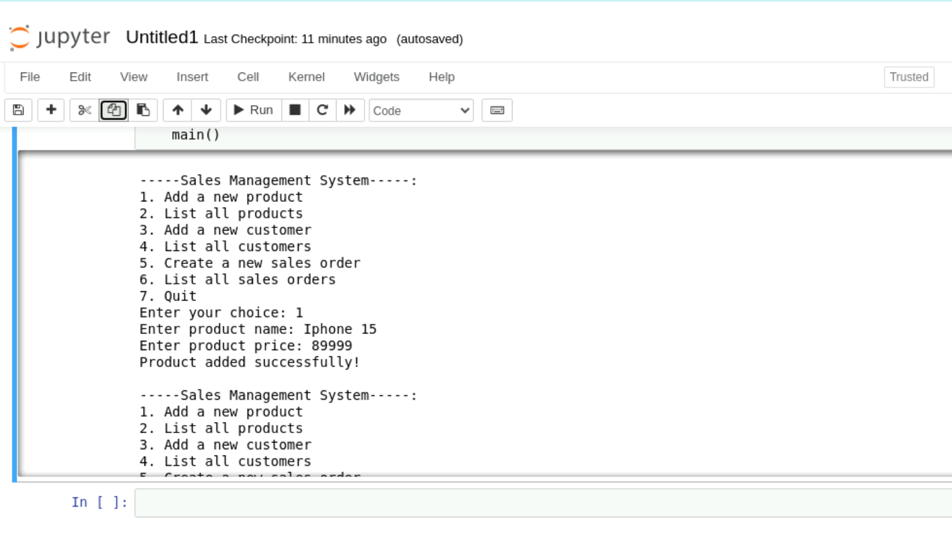
Command Line Sales Management System

Slide 62
Week Six
18th Sep – 22nd Sep

Slide 63
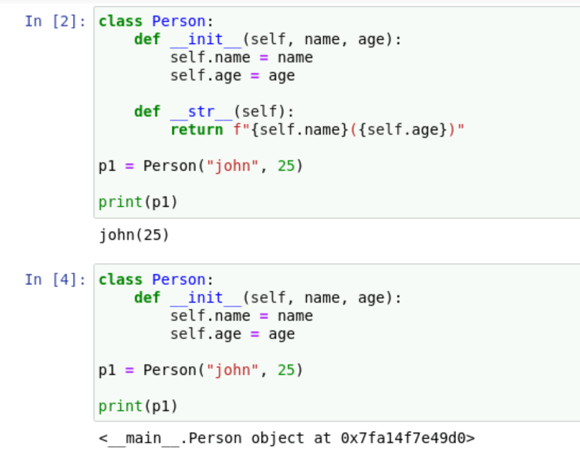
Python Classes

Slide 64
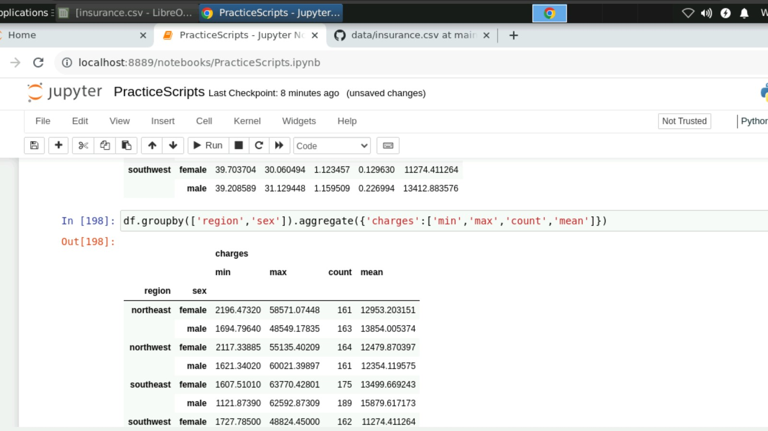
Working with Dataframes

Slide 65
Spark
RDD
Unified engine for large scale data analytics
Multi-language support – Python, R, Scala, Java, C#, SQL
Can be used over multiple clusters
Follows master-slave architecture
Batch processing, Real-time processing, Data analytics, Machine Learning, Graph processing, In-memory processing
Immutable – New RDD is created if update is carried out.
Type Inferred – Data type is inferred from the data itself.
Cacheable – can be made persistent
Lazy Evaluation – execute only when required to (when actions are called)
Fault Tolerance - recoverable

Slide 66
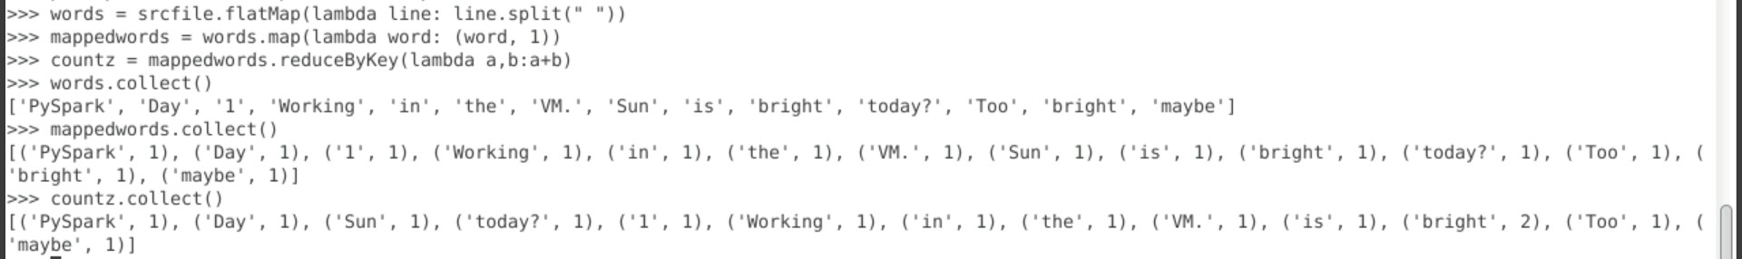
Word Count in a File using Spark

Slide 67
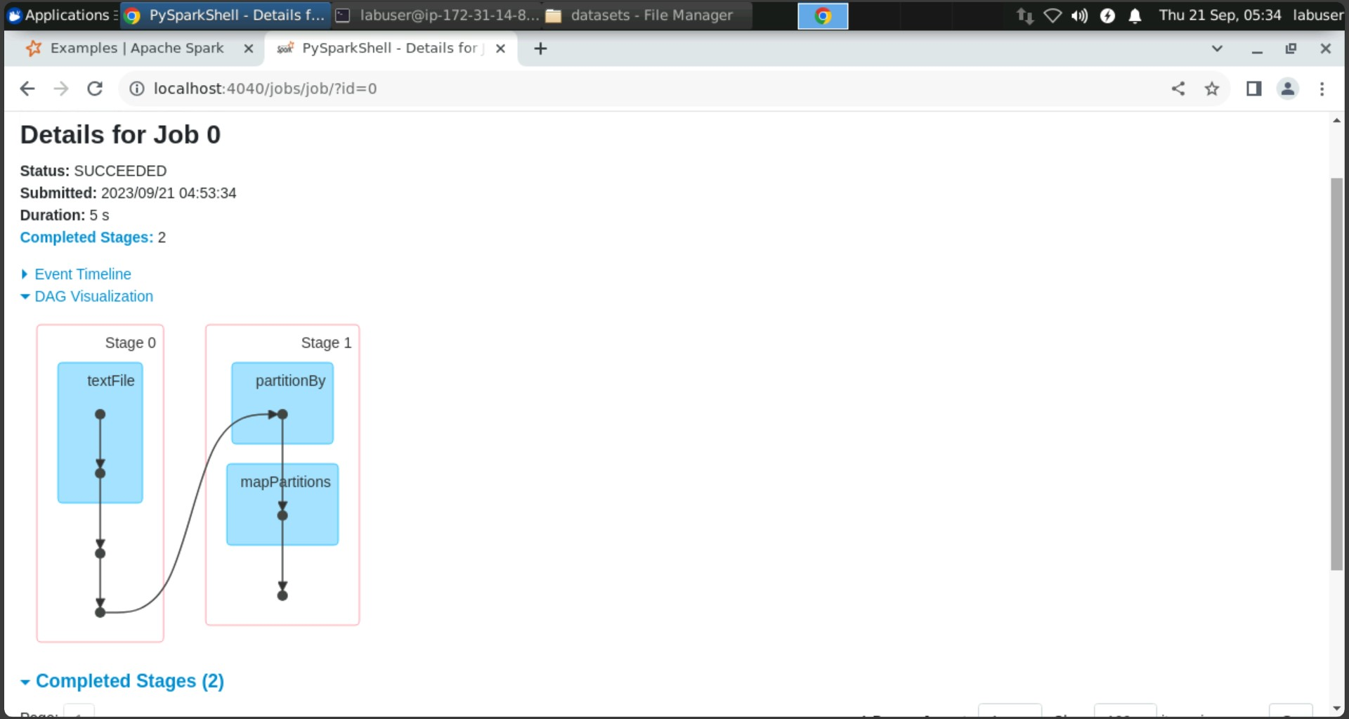

Slide 68
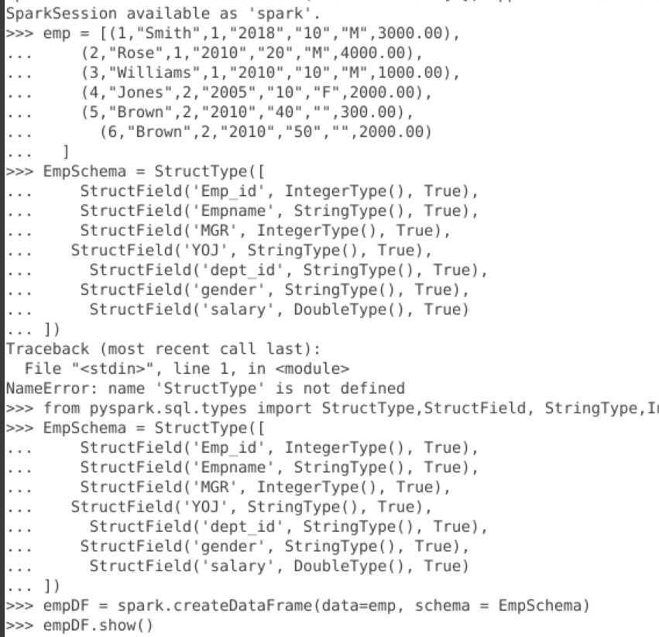
Creating Dataframes

Slide 69
